Slide 1

BY:- ASHMITA CHAUHAN (49947)

Slide 2
CONTENT
What is ATMA (Agricultural Technology Management Agency) ?
Objectives
Salient features
Funding
Beneficiaries and Benefits

Slide 3

What is ATMA ?
Agricultural Technology Management Agency (ATMA) scheme is benefitting the majority of farmers in overcoming the technological gaps in the industry.
The scheme aims at centralizing the management of agricultural technology transfer by making organizational arrangements and deploying innovative technologies.
ATMA acts a registered society in the respective States and encourages the farmers, farmer groups, Panchayat Raj Institutes, NGO, Krishi Vigyan Kendras (KVKs) and other stakeholders at the district and village levels to be a part of this farmer-centred extension system.
It offers technical advice and training on new practices and technologies to the farmers.

Slide 4
This Scheme was approved on 29th, March 2005.
The Scheme has made extension system farmer driven and farmer accountable.
237 Agricultural Technology Management Agency (ATMA) at district level have been set up to operationalise the extension reforms.
The release of funds are based on Strategic Research and Extension plan (SEWP)/ State Extension Work Plans (SEWPs) prepared by the State Governments.
252 districts across all the States/UTs in the country were covered under the scheme during the 10th Plan.

Slide 5
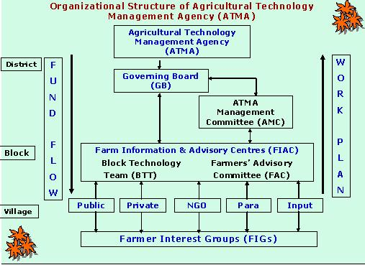

Slide 6

Objectives :-
To strengthen research – extension – farmer linkages
To provide an effective mechanism for co-ordination and management of activities of different agencies involved in technology adaption / validation and dissemination at the district level and below.
To increase the quality and type of technologies being disseminated.
To move towards shared ownership of the agricultural technology system by key shareholders.
To develop new partnerships with the private institutions including NGOs.

Slide 7
Salient Features of ATMA :-
Creating Farmer Advisory Committee to improve feed back.
Using NGOs to organize farmers.
Encouraging private sector involvement in technology transfer.
Validation and refining technologies through research units in the district.
Bottom up planning procedure.
Increased use of Information Technology (ARIS, WWW)
In-service training to increase staff competence.
Developing new Public-Private partnerships.
Formation and strengthening of farmer's interest group.

Slide 8

Funding :-
The scheme is suppported by the Central Government.
The funding pattern is 90% by the central Government and 10% by the state government.

Slide 9

Beneficiaries
Individual
Community
Women
Farmers/ Farm Women groups

Slide 10

Benefits:-
Exposure visit
Melas/ Fairs
Empowerment of farmers and farm women groups
Rewards and Incentives
Farmers/ Farm Women Interest groups are given training for demand driven production and marketing of farm produce. Rewards and incentives are given to the best performing groups.

Slide 11

THANK YOU

